Slide 1
AIAMC JEDI Webinar Series
Thur July 15, 2021
Approaching Equity, Diversity & Inclusion Across Med Educ 3 Approaches & Cross Cutting Themes
Deborah Simpson PhD, Steven D. Johnson MD,
Anne C Mosenthal MD, FACS & Jacob Bidwell, MD

Slide 2
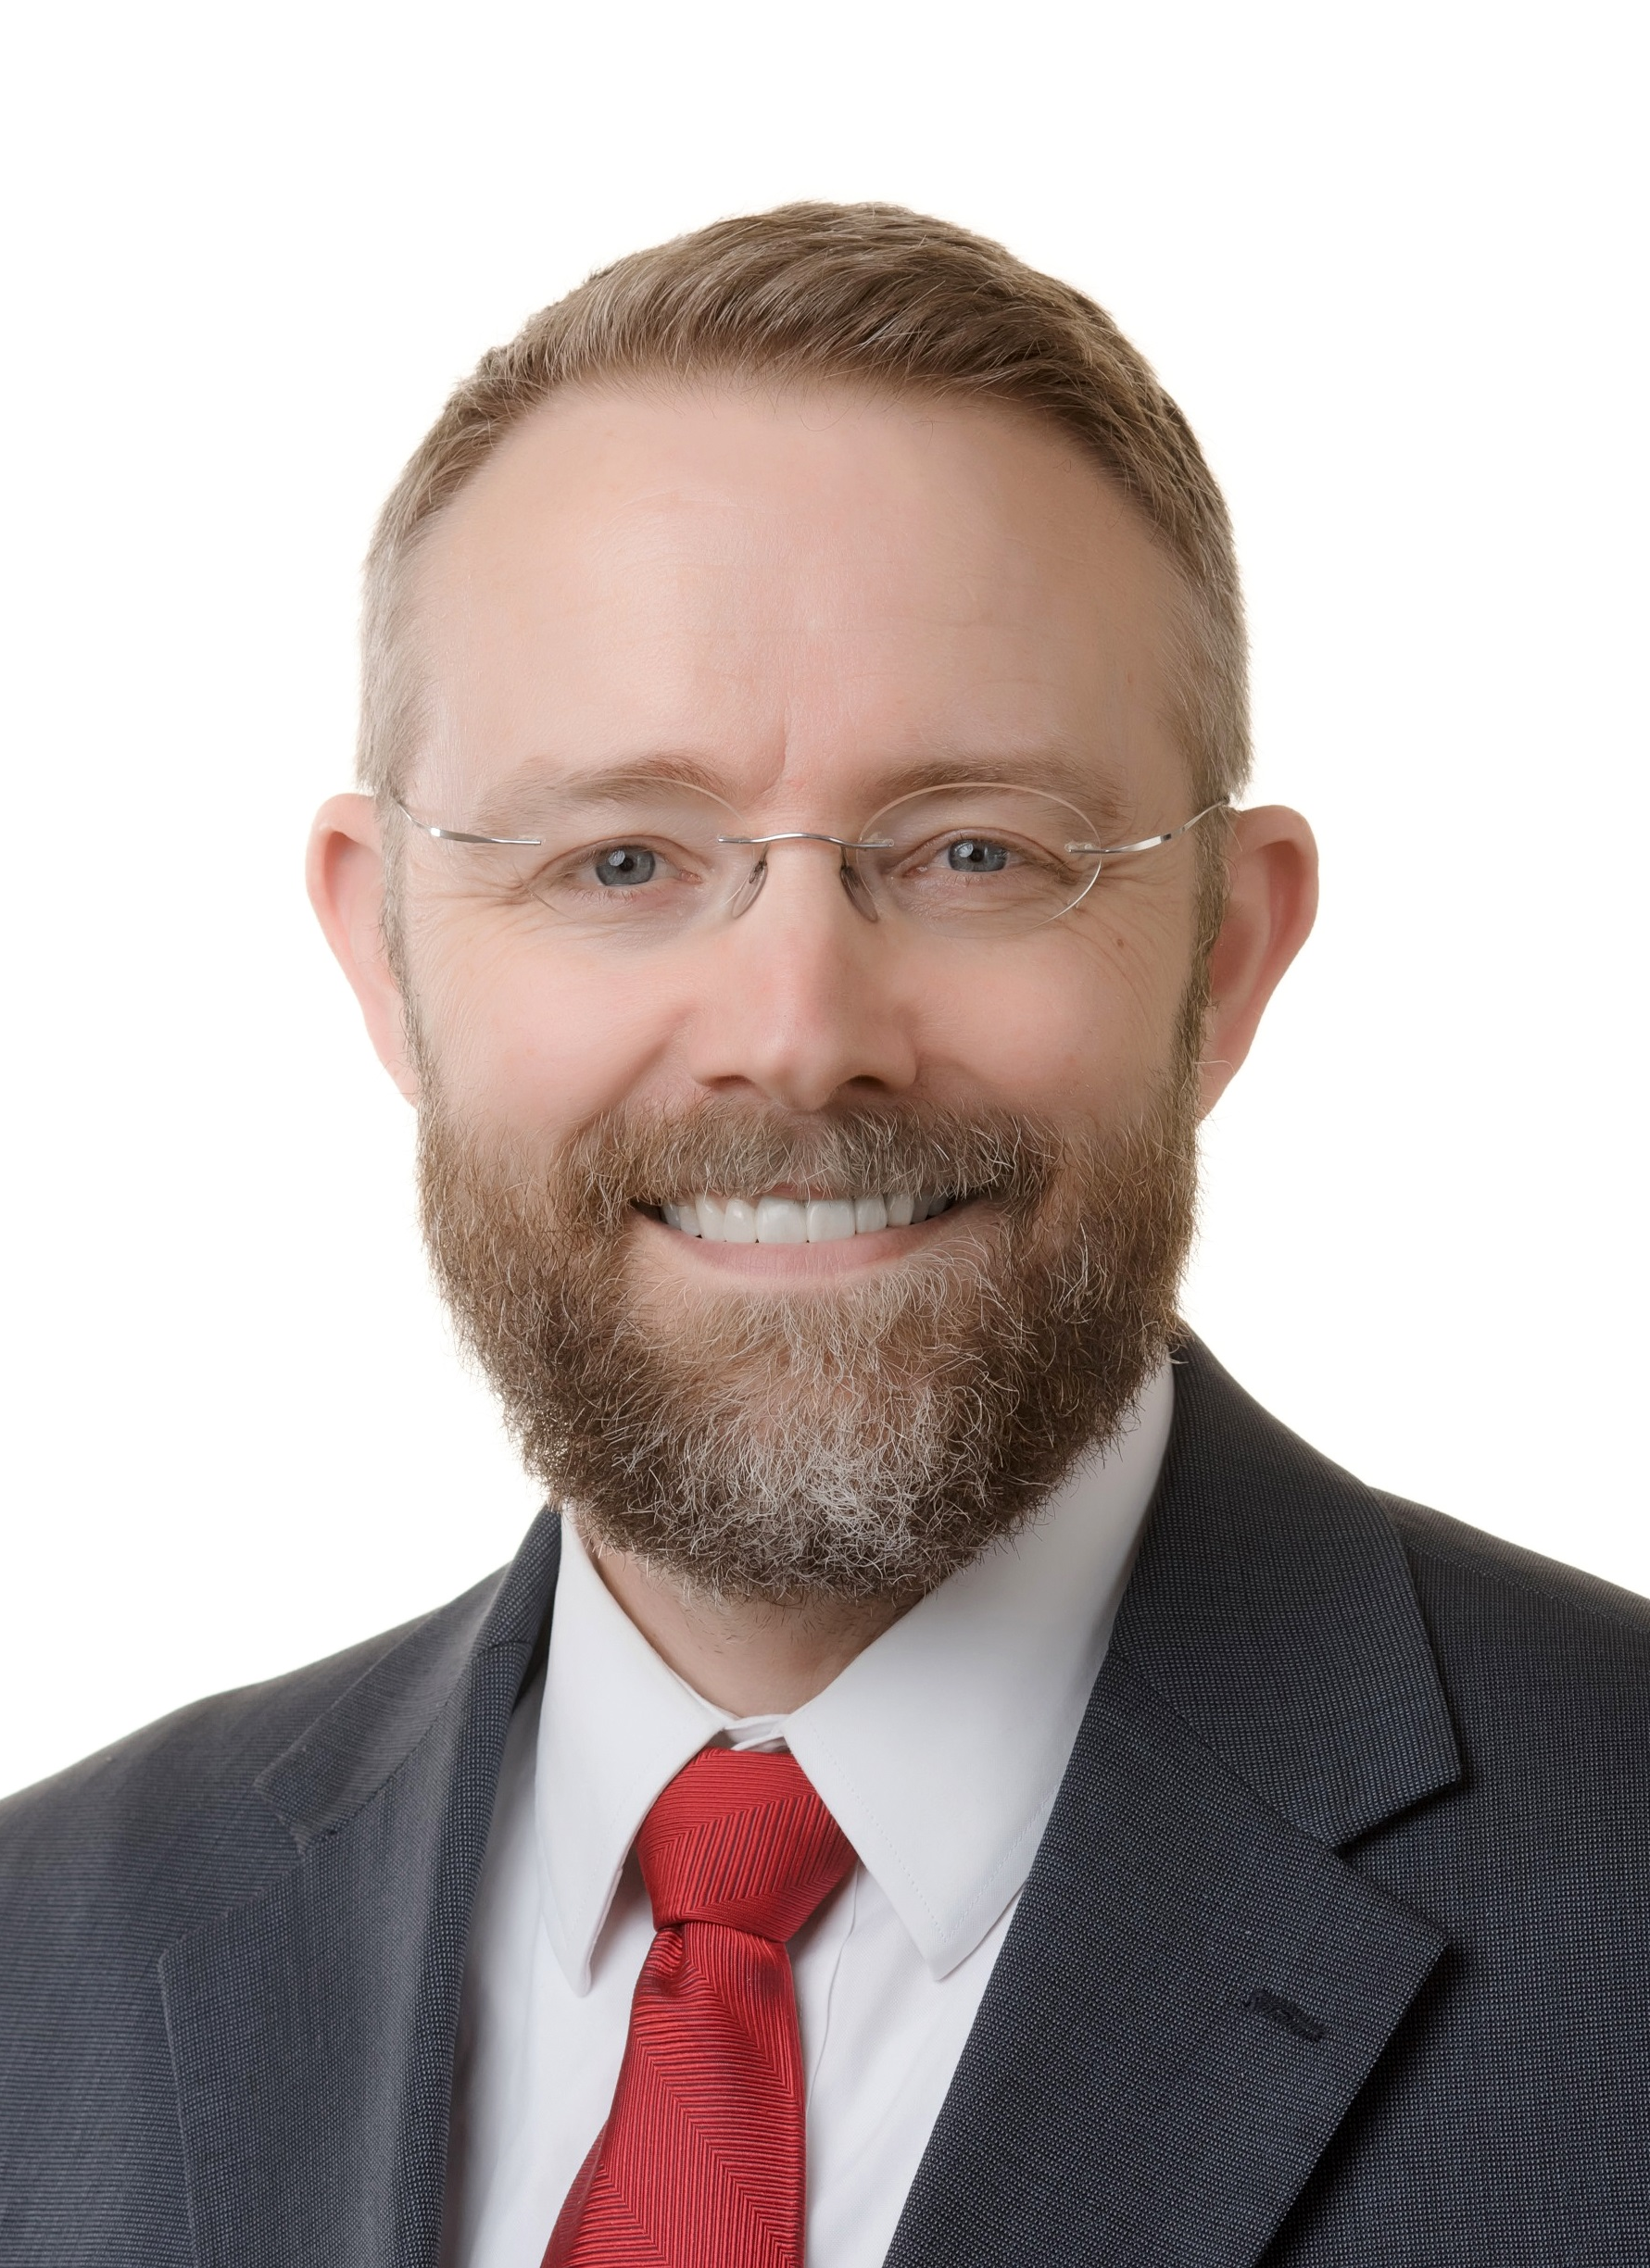
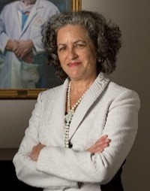
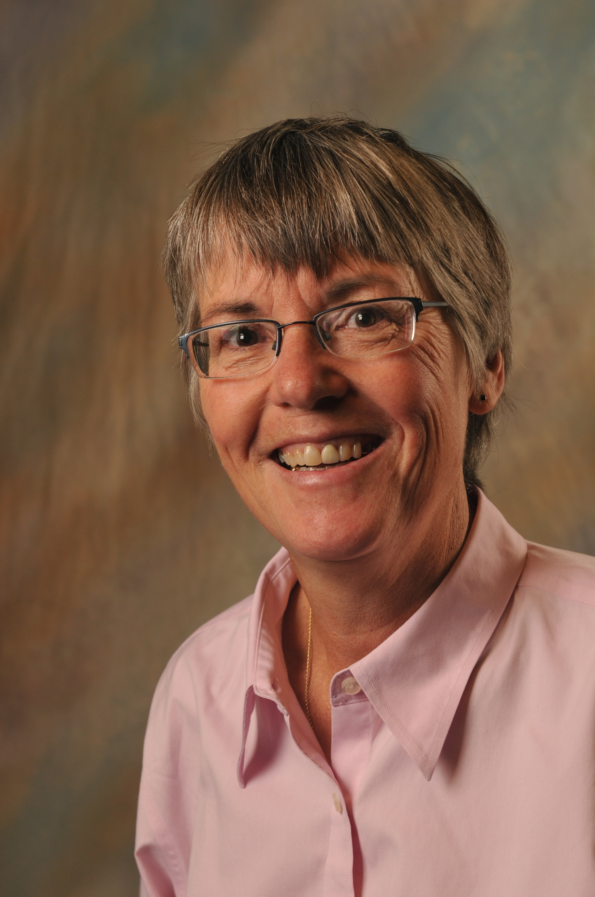
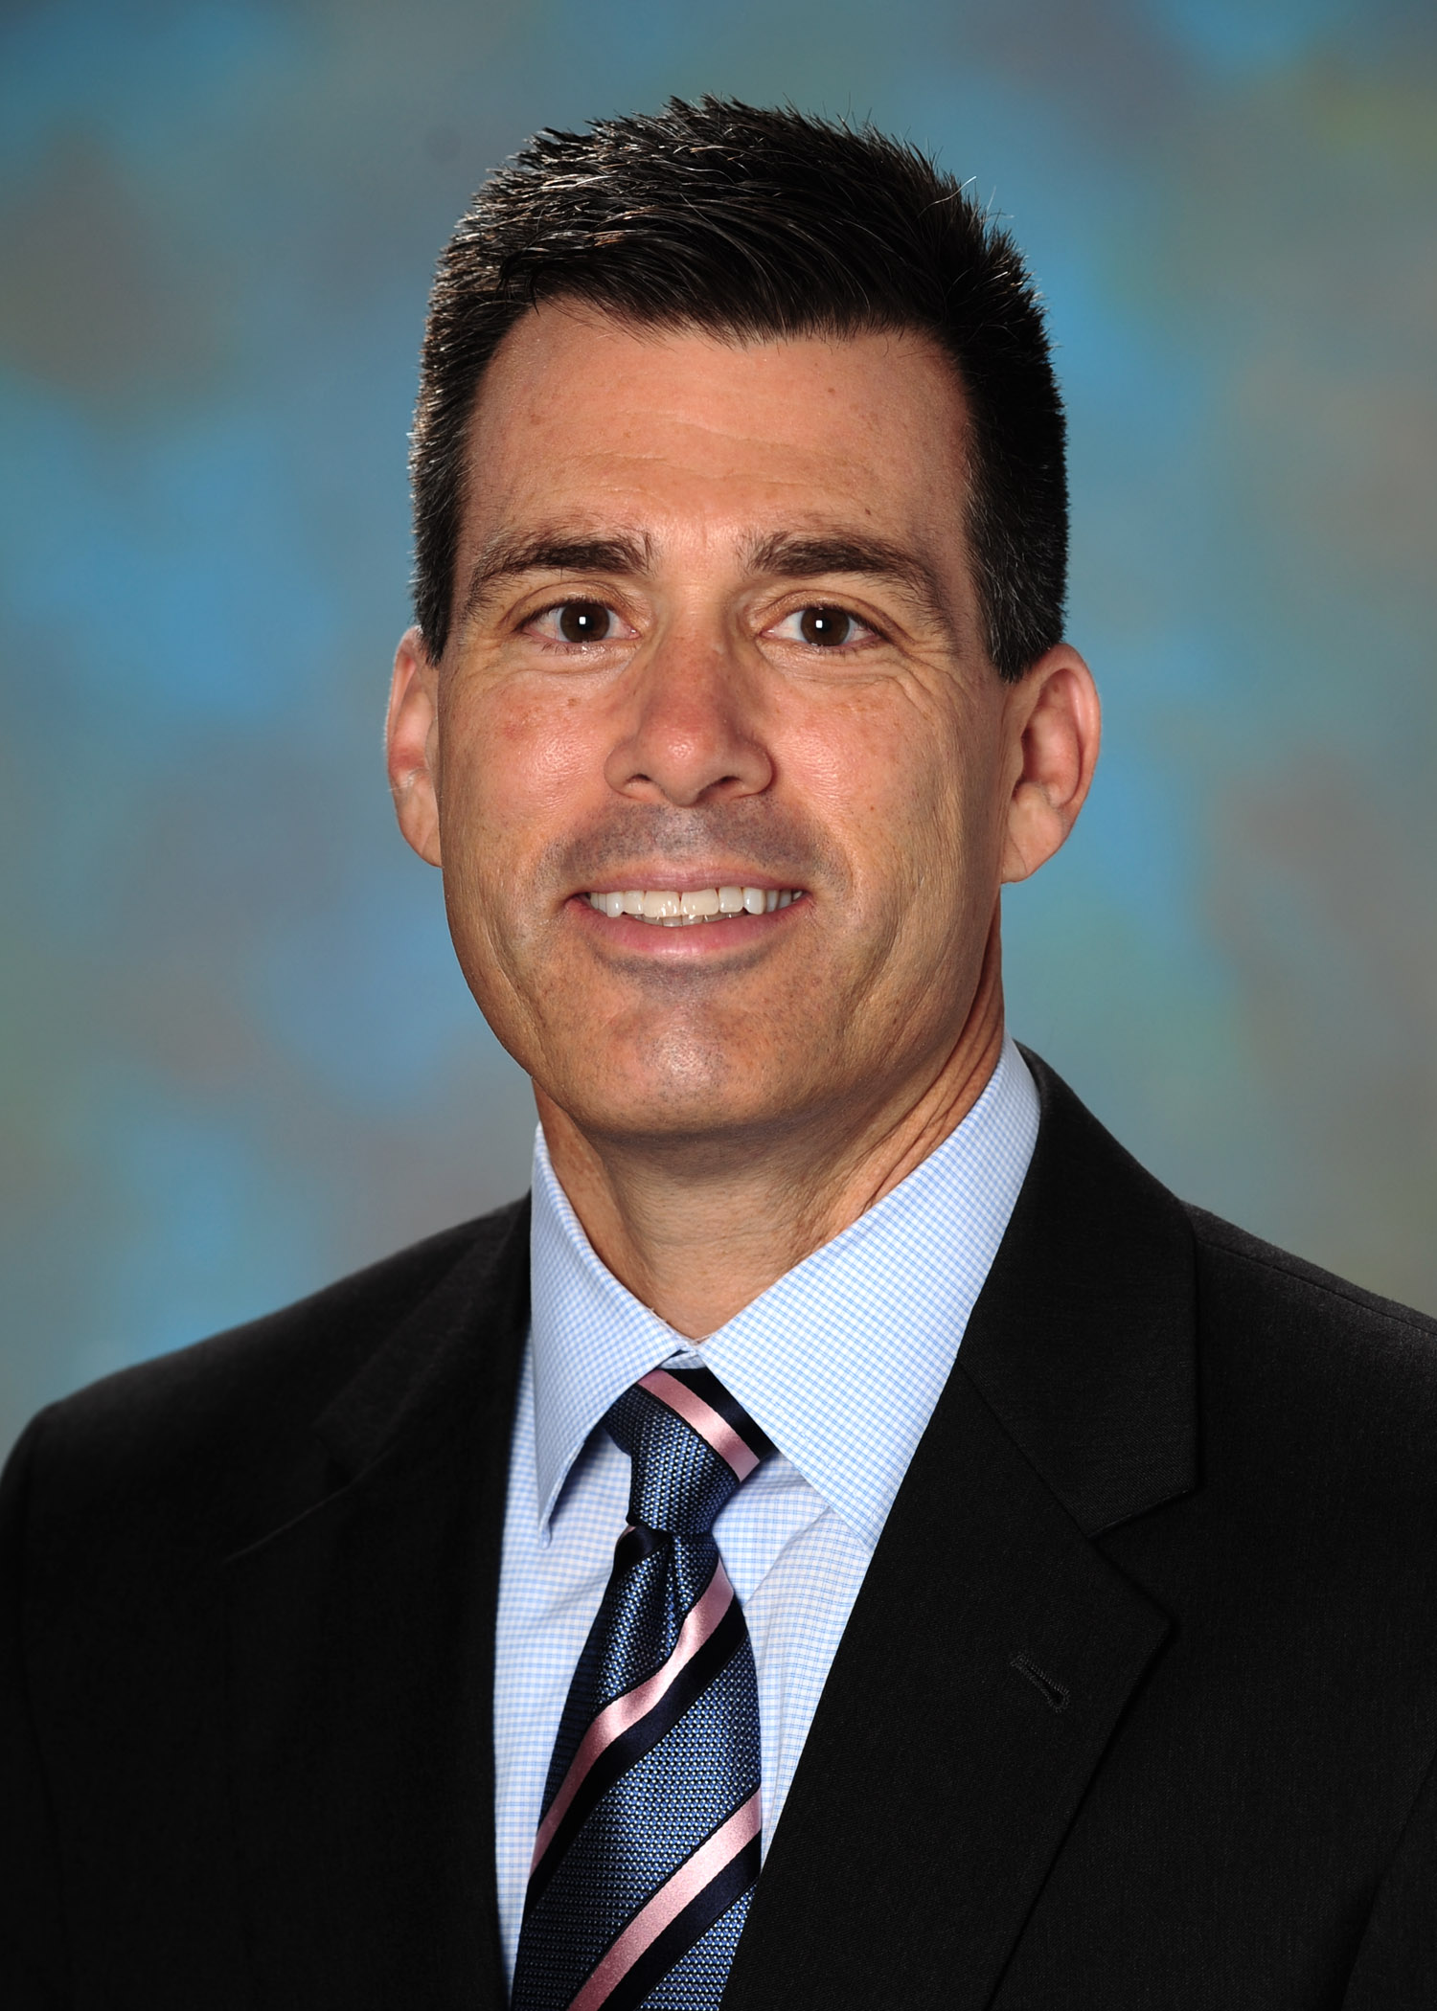
Today’s Presenters
Jacob Bidwell, MD
DIO and VP, Academic Affairs
Aurora Health Care
Anne Mosenthal, MD, FACS
Chief Academic Officer
Lahey Hospital & Medical Center
Deborah Simpson, PhD
Director, Education
Aurora Health Care
Steven Johnson, MD
DIO and VP, Academic Affairs
TriHealth

Slide 3
Background
Med educators long recognized need to address JEDI
Trainee and faculty recruitment
Implicit bias and policies
2020 – Vortex of Change
AIAMC List Serve inquiry
What & Metrics x Stakeholders (ACGME, C-Suite)
Raise Hand if you have initiated|reinvigorated|expanded JEDI efforts last yr

Slide 4
Agenda
Each of our presenter’s intro self & JEDI effort
1-2 Key Features
Metrics
Progress to Date
5 min each includes Qs of clarification
Break Outs Rooms [20 min]
90 second whip arounds
Intro self and JEDI Med Ed related activity
Something most excited about + Metrics
Discuss common themes & metrics
Facilitator Report Out [2 min x group]
Cross cutting themes
Opps for AIAMC Collaborations [NI-VII; Affinity Group, Policy]

Slide 5
Steven D. Johnson, MD Vice President of Academic Affairs/DIO
GME Strategic Plan
GME Diversity Advisory Council
Recruitment Initiatives
Journal Club

Slide 6
Diversity Advisory Council (DAC)
GME-specific DAC:
recognizes our unique role and needs
Inclusive:
Goals / Metrics:
GME commitment statements
DEI in GME brochure
Community Outreach
residents, fellows, program leaders, DEI partners

Slide 7
Recruitment
Standardized Training
Implicit Bias Training
Partnership w/Legal
Interviewing Tools
Behavioral interviewing
Implicit Bias ‘Pause’
Resident Feedback
Tip Sheet
Podcast

Slide 8
DAC Journal Club
Ground Rules
Articles
Promote honest dialogue

Slide 9
Anne C Mosenthal MD, FACS
Academic Dean Tufts University SoM
I. SafeSpot and Safety Huddle Reporting
II. Policy: Responding to Bias from patients
III. Training: How to be an Upstander
Prevalence of bias/microaggressions
Tools and guide on how to respond and report
GME – program directors, residents, APP, nursing
Managers and supervisors
Institution Response
To Microaggressions
From Patients:
Phases I-III

Slide 10
Safe Spot Reporting
2-3 weekly bias events reported by employees
Coming from:
patients and/or families
co-workers and colleagues
Most commonly directed at employees lower in hierarchy:
Nursing assistants
Medical assistants
Trainees
But all colleagues vulnerable… includes physicians
Race
Gender
National Origin
Substance Use Disorder
Age
Socioeconomic / Class
Gender Identity
Sexual orientation
Disability

Slide 11
Policy: Responding to Incidents of Bias and Discrimination from Patients and Visitors in the Workplace
Statement
Commitment to safe, respectful environment
Expectations for patient, family behavior
Addresses common microaggressions:
….race, gender, origin…
“my wife doesn’t like to be touched by black people, so …”
Procedure
Stop and acknowledge the inappropriate behavior, comment, or request
Redirect back to the patient’s medical issues
Support the caregiver and reiterate and validate the caregiver’s concerns

Slide 12
TRAINING: How to be an Upstander Workshops
Wave I: Interns, residents, program directors
Facilitator Training – building capacity, identify champions in clinical learning environment, across professions
Wave II: team training, MD, APP, nursing, environmental services
A. Shaffer

Slide 13
Academic Affairs DE&I Plan Across Med Ed Continuum Metrics: EDI Milestone & Evaluation items
Jacob Bidwell, MD
DIO Aurora & VP Acad Affairs

Slide 14
Academic Affairs Diversity, Equity & Inclusion Action Plan
Purpose & Culture
Recruitment & Retention
Curriculum & Program Structure
Evaluation, Assess & Inquiry
Mission statements reflect DE&I
Examine/revise policies & procedures for DE&I → safe, supportive culture
Create incident report category for microaggressions
Clinician Bill of Rights -‘isms” by pts
5. Academic Affairs will reflect population we serve by 2026
Faculty, Staff & GME Programs (residents, fellows) & students*
Welcoming “culture” to support recruitment/retention
Shift in applicant evaluation and ranking paradigm(s)
Performance Assessments
Structural fluency milestone from
Student → CME
Evaluation forms add DE&I item(s)
Rotation, Teaching, Alumni
Scholarly inquiry incorporate DE&I elements
6. Every education offering must include DE&I specific to REAL-G+
Address Equity (ex: race based clinical protocols and formulas)
7. DE&I Education
Micro aggression scripting sessions
8. Performance Improvement: All QI/Change Initiatives include DE&I
Apply IHI Model for Improvement
Notes:
Adapted From: Guh J, Harris C, Martinez P, Chen F, Gianutsos LP. Antiracism in residency: a multimethod intervention to increase racial diversity in a community-based residency program. Family mDE&Icine. 2019;51(1):37-40.
South EC, Butler PD, Merchant RM. Toward an equitable society: building a culture of antiracism in health care. The Journal of Clinical Investigation. 2020 Jul 21.
REAL-G: Race, Ethnicity, Age, Language/Litearcy – Gender +
OSU Wesner MDE&Ical Center and Health Science Colleges ACTion Plan: South EC, Butler PD, Merchant RM. Toward an equitable society: building a culture of antiracism in health care. The Journal of Clinical Investigation. 2020 Jul 21.
BIPOC = black, Indigenous, and people of color

Slide 15
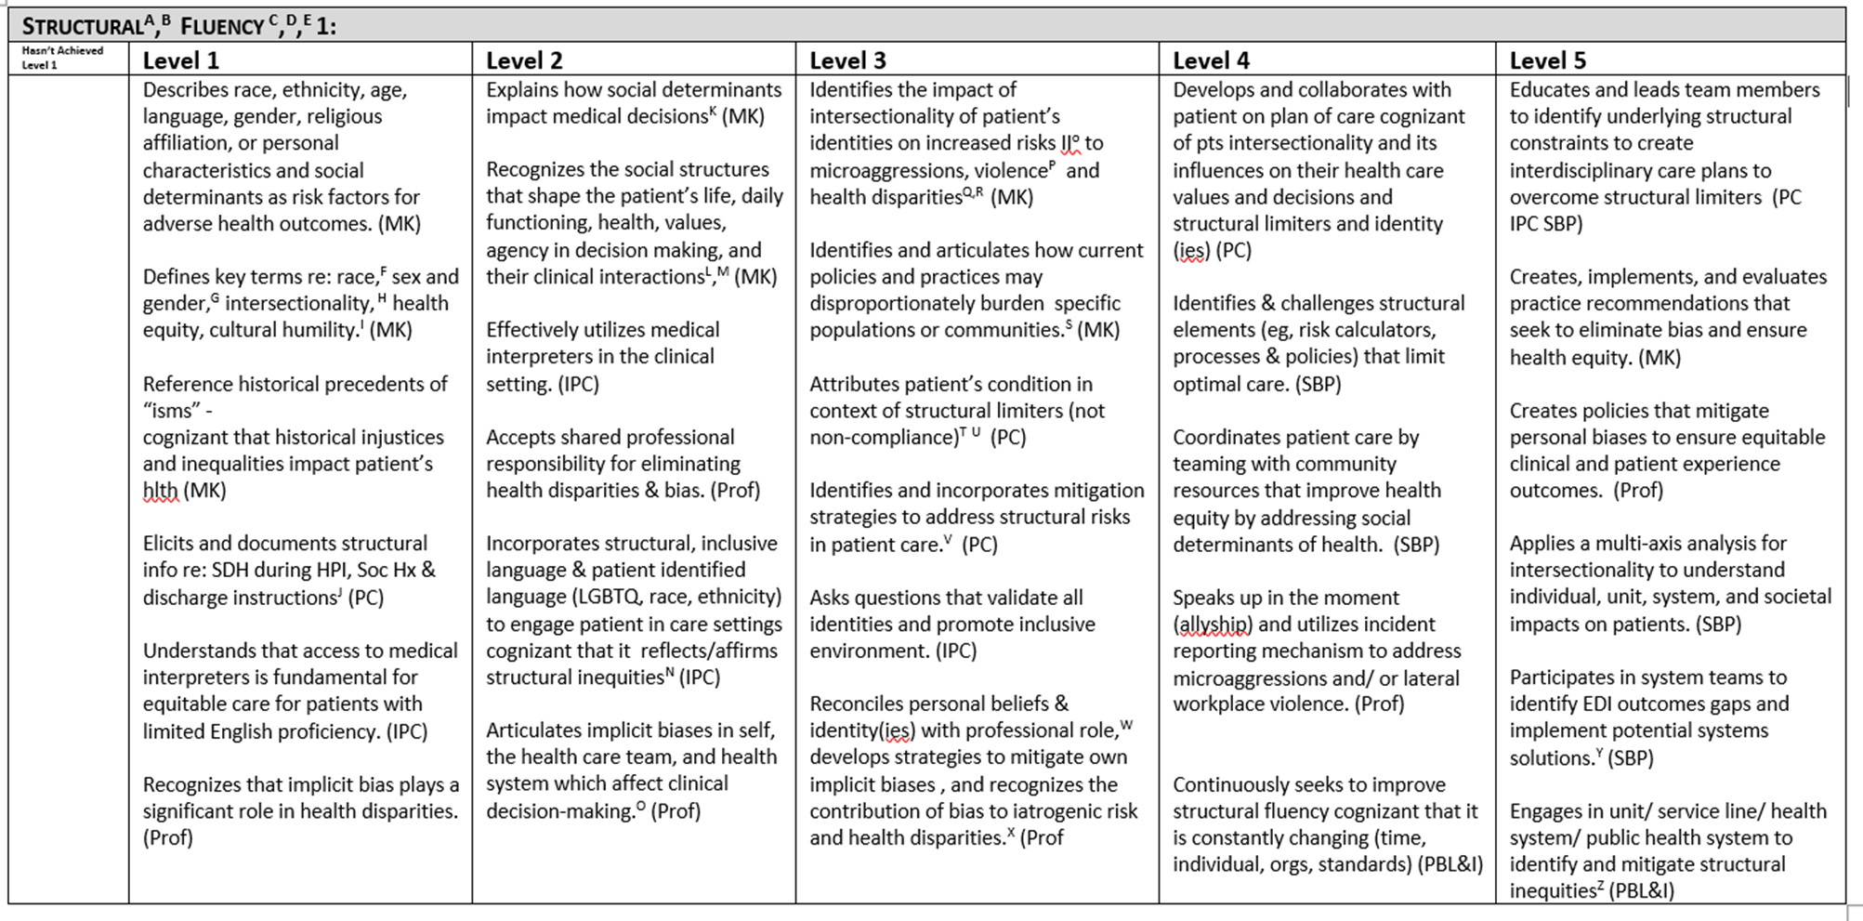
1- Page x MedHub Milestone - Jan 2021

Slide 16
W-GMEC Evaluation Questions
Clinical Teaching Evaluation (July 2020)
Promotes and Champions EQUITABLE OUTCOMES (e.g., Seeks to reduce health care disparities; Treats all patients and families with kindness and respect; Discusses population-based care; Encourages trainees to address social determinants of health; Reinforces effective use of interpreting services) [1= Strongly Disagree to 6 = Strongly Agree]
End of Rotation Evaluation (Oct 2020)
Climate Promoted Equity, Diversity & Inclusion: All learners were included & treated with respect; diversity was explicitly valued, implicit biases were acknowledged, and mitigation strategies deliberated; health and educational equity goals and outcomes were explicitly discussed during this rotation. [1 = Very Often to 5 Never]
Universal Educ Session Evaluation(for j-clubs, core curriculum sessions, case conferences) (Oct 2020)
Climate Promoted Equity, Diversity & Inclusion: During this session all learners were included & treated with respect, diversity was explicitly valued as time allowed, implicit biases were acknowledged, and mitigation strategies deliberated; any images/representations of patients/disease/conditions reflect the diverse populations we serve; health & educational equity goals and outcomes were explicitly discussed. [1= Strongly Disagree to 5= Strongly Agree]
4. Alumni Survey (Feb 2021) [Minor Modification of End of Rotation Eval]

Slide 17
“How to be an Anti-Racist” - Dr. Ibram X. Kendi
The opposite of racist isn’t “not racist”. It is “anti-racist”.
One either allows racial inequities to persevere, as a racist, or confronts racial inequities, as an anti-racist. There is no in-between safe space of “not racist”.
Like fighting an addiction, being an antiracist requires persistent self-awareness, constant self-criticism, and regular self-examination.
To be antiracist is to view the inequities between all racialized ethnic groups as a problem of policy.
Every policy in every institution in every community in every nation is producing or sustaining either racial inequity or equity between racial groups.

Slide 18
Break Outs!! [20 min]
90 second whip arounds
Intro self & JEDI Med Ed related activity
Something most excited about + Metrics
Identify common themes & metrics
Recs for AIAMC

Slide 19
Break Out Report Outs!
Cross Cutting Themes
Metrics
Recommendations

Slide 20
Evaluation
The AIAMC Programming Committee is requesting your feedback. Please take a few minutes to complete our brief questionnaire here:
https://www.surveymonkey.com/r/AIAMC_2021_Webinar_Series_July_15_2021

Slide 21
AIAMC JEDI Webinar Series
Thur July 15, 2021
Approaching Equity, Diversity & Inclusion Across Med Educ 3 Approaches & Cross Cutting Themes
Deborah Simpson PhD, Steven D. Johnson MD,
Anne C Mosenthal MD, FACS & Jacob Bidwell, MD

